Slide 1
The Right Decision Service (RDS)
Bringing evidence for decision-making to the fingertips of practitioners and citizens

Slide 2
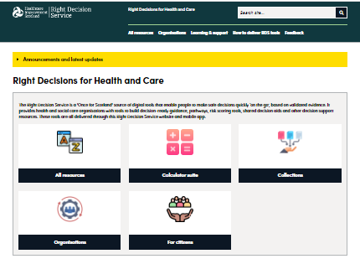
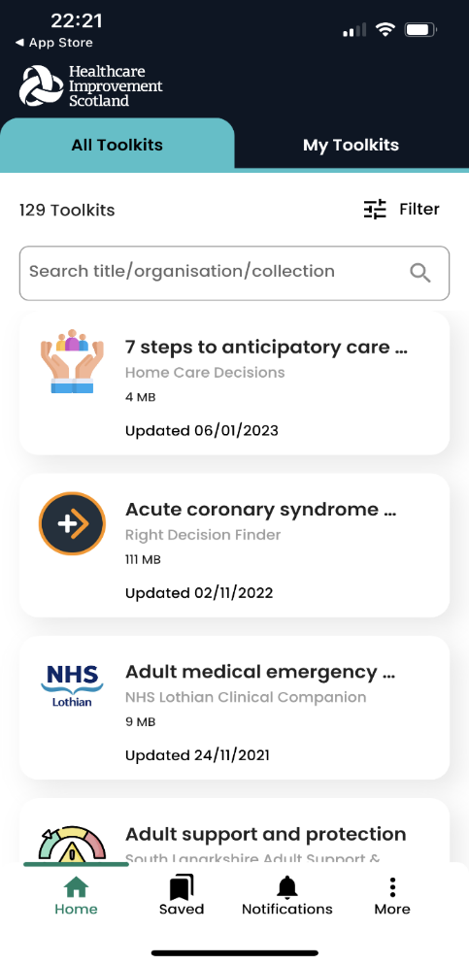
What is the Right Decision Service?
A Once for Scotland platform for digital tools that puts evidence in the hands of staff and citizens through day-to-day technology - web and mobile apps, and embedding in electronic care systems.
In this way, the Right Decision Service enables people to make safe, personalised decisions quickly, ‘on the go,’ based on validated evidence.

Slide 3
Guidelines and pathways
Design principles
Single point of access.
Current, trustworthy evidence delivered quickly and succinctly at the point-of-care.
Simple presentation
Transparency around evidence quality
Ability to delve deeper to see further detail.
Benefits:
Save practitioner time
Consistent, safe evidence-informed practice.

Slide 4
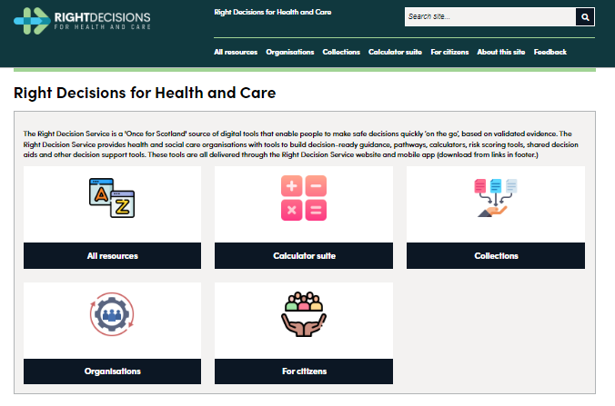
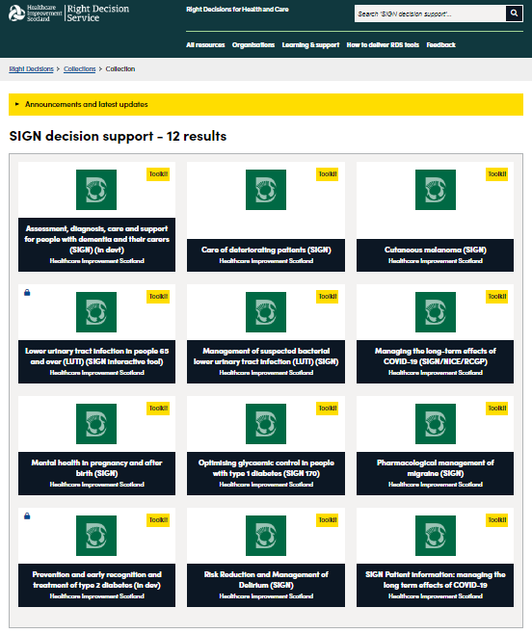
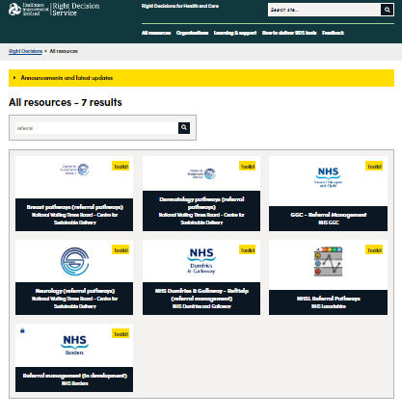
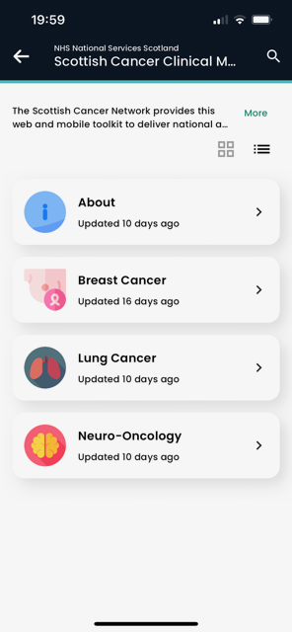
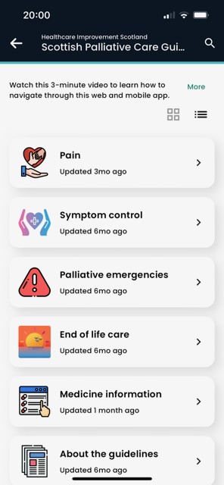
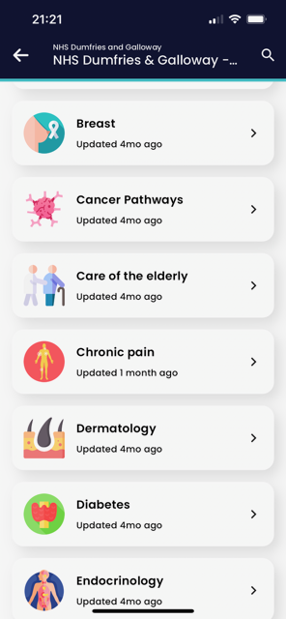
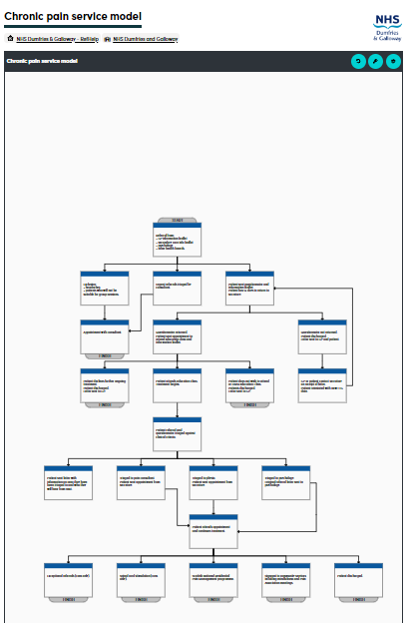
Guidelines and pathways - examples
Referral management pathways

Slide 5
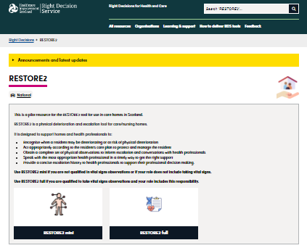
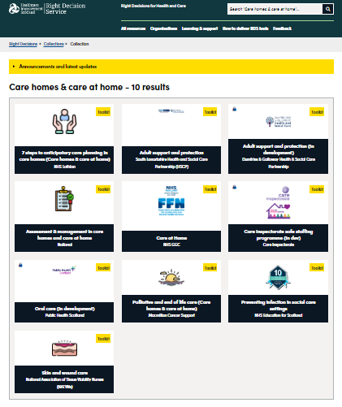
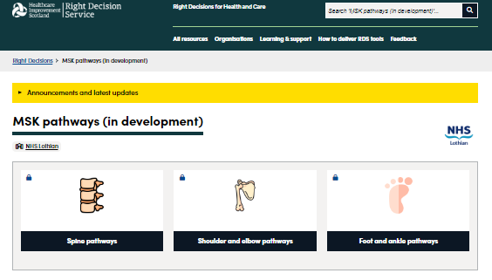
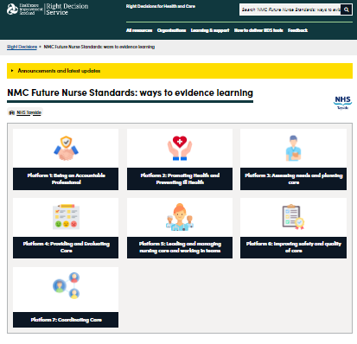
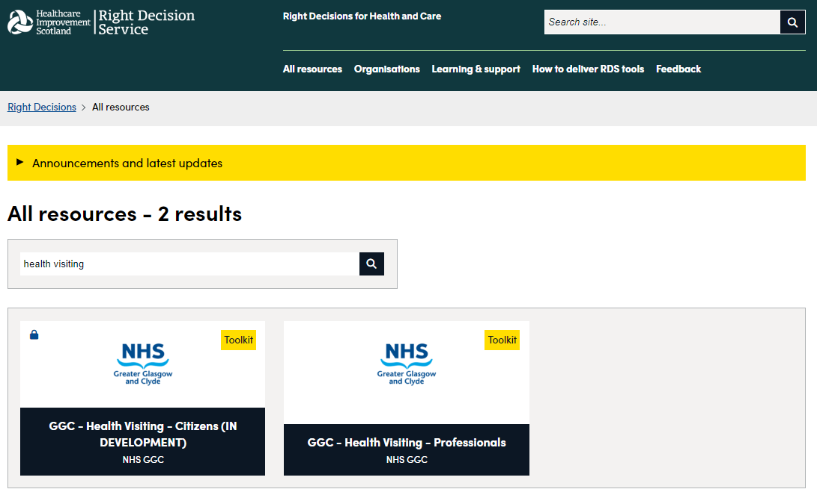
Supporting all professional groups

Slide 6
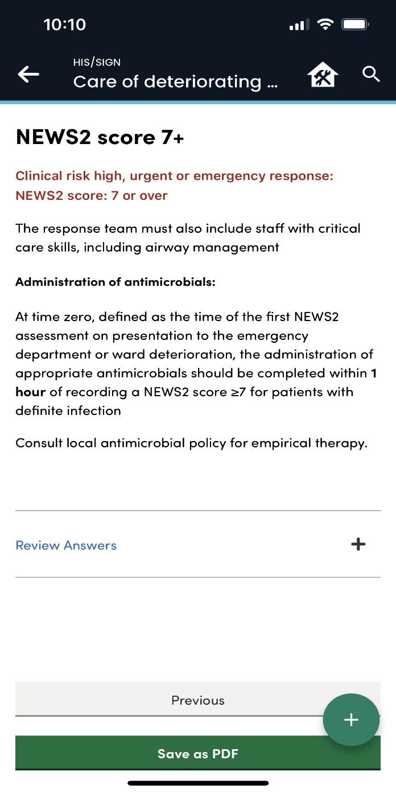
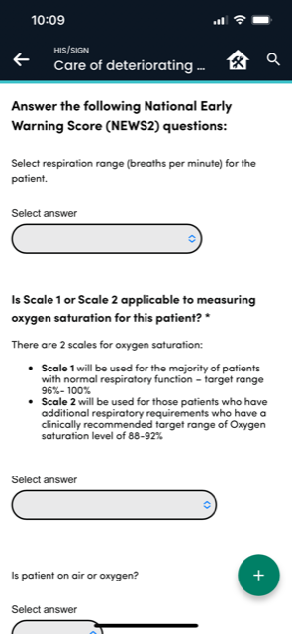
NEWS2 Calculator (within SIGN Care of deteriorating patients guideline)
Computer-executable knowledge

Slide 7
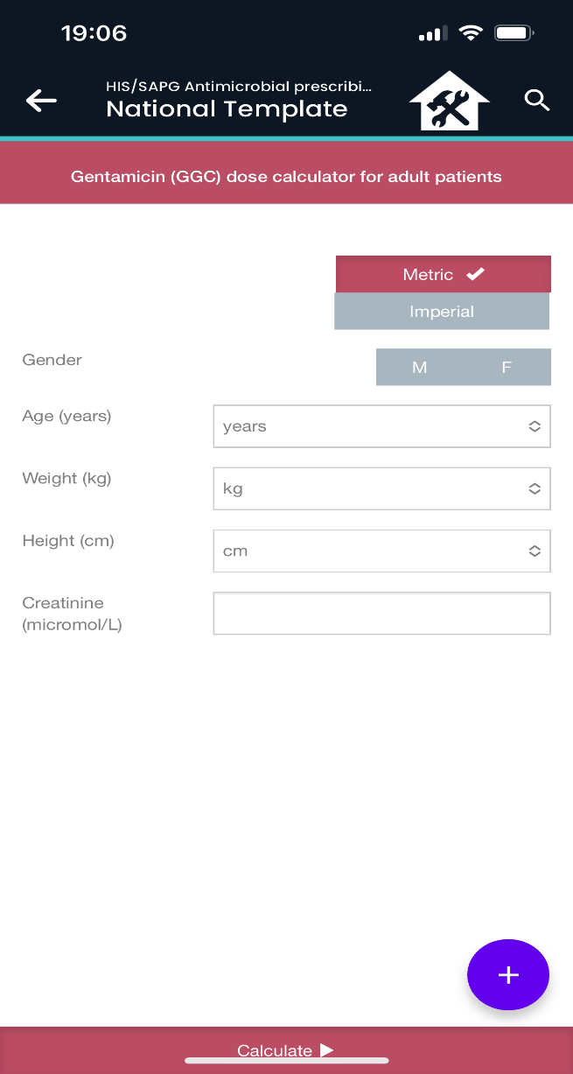
Complex calculators – e.g. antimicrobial prescribing
[140 – age (years)] x weight (kg) x [1.23 (male) OR x 1.04 (female)] Creatinine clearance = -------------------------------------------------------------------------------------------- CrCl (mL/min) serum creatinine (micromol/L)
Actual body weight ® Cr Cl (mL/min) ¯ | 40 - 49 kg | 50 - 59 kg | 60 - 69 kg | 70 - 80 kg | > 80 kg
< 21 | 2.5 mg/kg (max 180 mg) then take a sample after 24 hours
21 - 30 | 180 mg 48 hourly | 200 mg 48 hourly | 240 mg 48 hourly | 240 mg 48 hourly | 260 mg 48 hourly
31 - 40 | 200 mg 48 hourly | 240 mg 48 hourly | 280 mg 48 hourly | 300 mg 48 hourly | 320 mg 48 hourly
41 - 50 | 240 mg 48 hourly | 280 mg 48 hourly | 320 mg 48 hourly | 360 mg 48 hourly | 400 mg 48 hourly
51 - 60 | 200 mg 24 hourly | 240 mg 24 hourly | 280 mg 24 hourly | 300 mg 24 hourly | 320 mg 24 hourly
> 60 | 240 mg 24 hourly | 280 mg 24 hourly | 320 mg 24 hourly | 360 mg 24 hourly | 400 mg 24 hourly

Slide 8
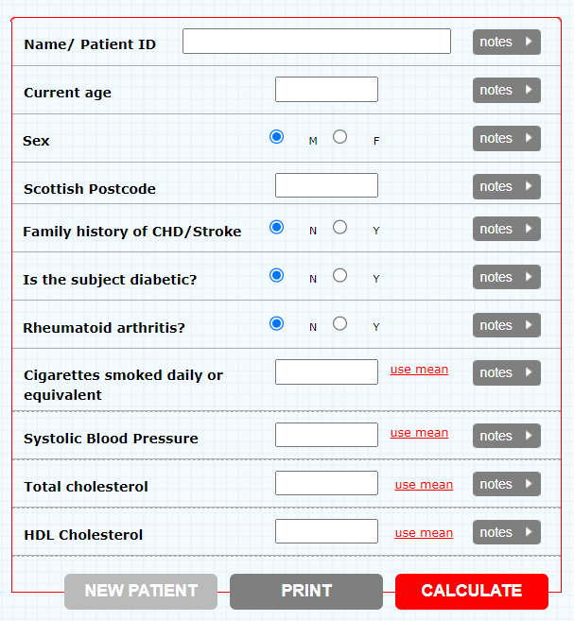
ASSIGN (v.2.0): Update of cardiovascular risk score
Men The betas (log hazard ratios) for each risk factor are: bage=0.05698, btc=0.22286, bhdlc=−0.53684, bsbp=0.01183, bdiabetes=0.81558, bfamily=0.27500, bcpd=0.02005, bSIMDSC10=0.06296. For each person, define: L=bage*age+btc*tc+bhdlc*hdlc+bsbp*sbp+bdiabetes*diabetes+ bfamily*family+bcpd*cpd+bSIMDSC10*SIMDSC10.
An asterisk denotes multiplication. Evaluate L at the mean values: Lbar=bage*48.8706+btc*6.22520+bhdlc*1.35042+bsbp*133.810+bdiabetes*0.0152905+bfamily*0.2 63762+bcpd*7.95841+bSIMDSC10*2.74038. Let A=L-Lbar and B=exp(A). Then the ASSIGN score is P=100*(1-(0.8831B )), where 0.8831 is the 10y survival rate, free from CVD, for men in SHHEC.
Women Similarly, bage=0.07203, btc=0.12720, bhdlc=-0.55836, bsbp=0.01064, bdiabetes=0.97727, bfamily=0.49159, bcpd=0.02724, bSIMDSC10=0.09386. Define L, A and B as for men. Lbar=bage*48.7959+btc*6.40706+bhdlc*1.62837+bsbp*130.115+bdiabetes*0.0127275+bfamily*0.3 26328+bcpd*6.44058+bSIMDSC10*2.82470. Then, P=100*(1-(0.9365B )), where 0.9365 is the 10 year survival rate for women.

Slide 9
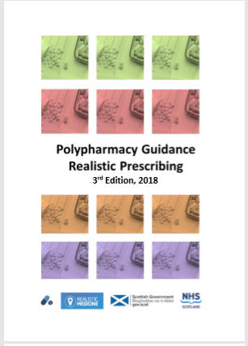
Patient-specific decision support in patient record

Slide 10
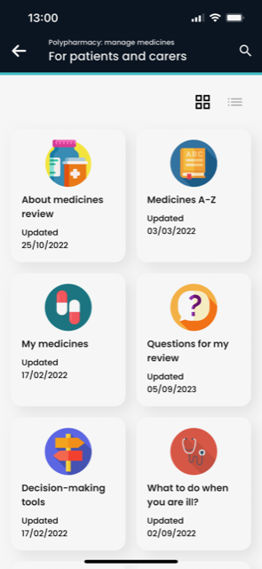
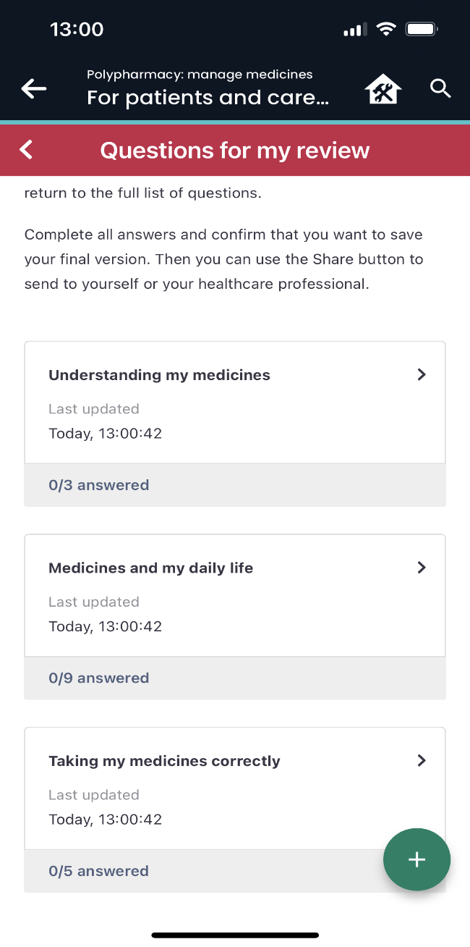
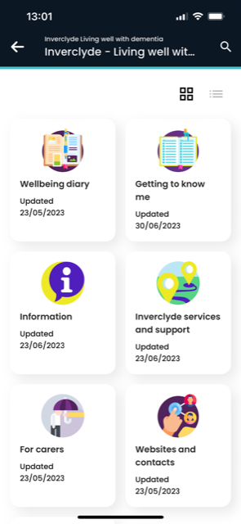
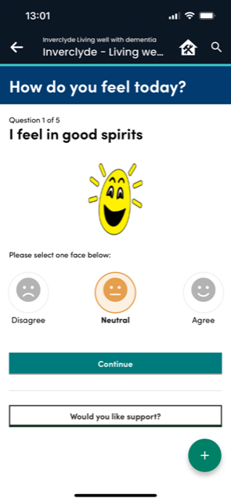
Personalised, shared decision-making
Medicines management
Wellbeing in dementia

Slide 11
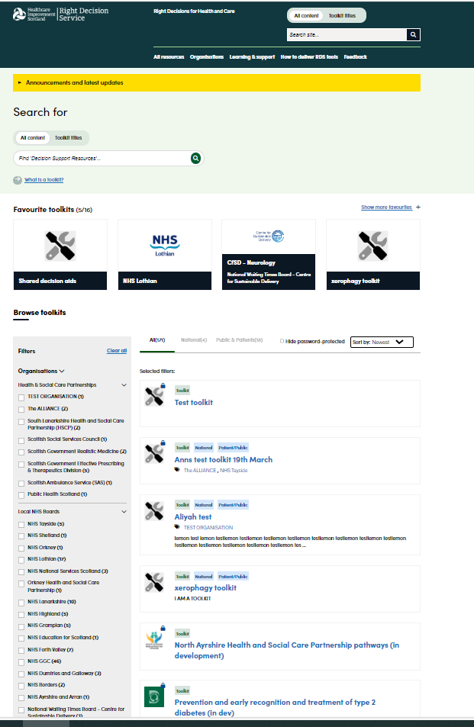
Redesign of:
RDS Search and Browse
Archiving, Deep linking

Slide 12
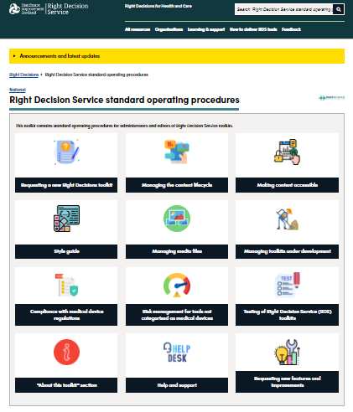
Governance
Governance
Updated Terms and Conditions of Use
Makes responsibility of organisations delivering their content via RDS clear.
Upgraded standard operating procedures
Cover local governance, content development and review, testing and risk management
Set out acceptance criteria for delivery of content via RDS.
Implemented prospectively since September 2023 and retrospectively.
InnoScot Health as registered manufacturer for 10 RDS tools classified as low risk medical devices.

Slide 13
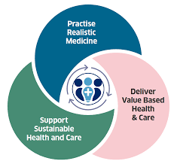
Benefits of RDS to Value and Sustainability
Reducing harm
Reducing unwarranted variation
Shared decision-making
Personalised care
Saving time
Making best use of available resource

Slide 14
Adoption of the Right Decision Service
Adoption at scale
Between 1 January and 31 December 2023:
1,777,077 unique users
10.4 million page views.
Over 180 web and mobile decision support toolkits delivered through RDS
37 organisations and programmes delivering content through RDS.

Slide 15
Impact – February 2024
Direct delivery of care
Clinical decision-making
High impact: 55% Some impact: 32%
Reducing variation in practice
High impact: 65% Some impact: 26%
Improving patient safety
High impact: 59% Some impact: 26%
Service delivery
Saving time
High impact: 65% Some impact: 25%
Devolving decision-making
High impact: 60% Some impact: 25%
Workforce knowledge and skills
High impact: 66% Some impact: 26%

Slide 16
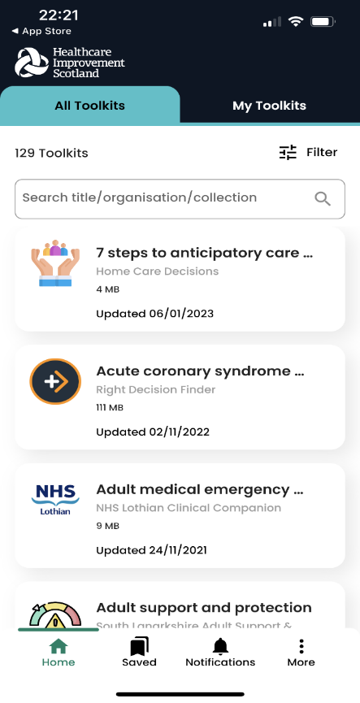
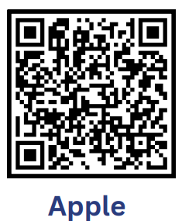
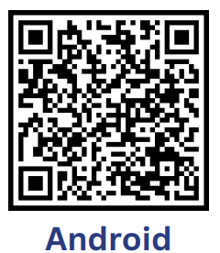
Web and mobile access https://rightdecisions.scot.nhs.uk
Contact: his.decisionsupport@nhs.scot
Notes:
Content includes guidelines, calculators, pathways, handbooks
A number of HBs have chosen to use RDS as their platform for clinical resources eg Glasgow, Highland

Slide 17
The Right Decision Service (RDS)
Bringing evidence for decision-making to the fingertips of practitioners and citizens

